Slide 1
Operating Systems Architecture

Slide 2
Operating System (OS)
The operating system is program that acts as an intermediary between a user of a computer and the computer hardware
In other words, it’s the interface between the hardware and the user.
The primary roles of the operating system are to:
Coordinate executing of programs
Make the computer system convenient to use
Utilize the computer hardware in an efficient manner
The OS provides an abstraction – making it easier for applications to work with each other without causing conflicts.
Notes:
1.

Slide 3
What Operating Systems Do
For workstations, provides users convenience, ease of use and good performance
For shared computers such as mainframes or servers it must keep all users happy
Users of dedicate systems such as workstations have dedicated resources but frequently use shared resources from servers
Handheld computers are resource poor, so optimized for usability and battery life
Some computers have little or no user interface, such as embedded computers in devices and automobiles

Slide 4
What is an OS?
It’s a resource allocator
Manages all resources
Decides between conflicting requests for efficient and fair resource use
It’s a control program
Controls execution of programs to prevent errors and improper use of the computer
“The one program running at all times on a computer” is the kernel.
Everything else is either
a system program (ships with the operating system) , or
an application program.

Slide 5
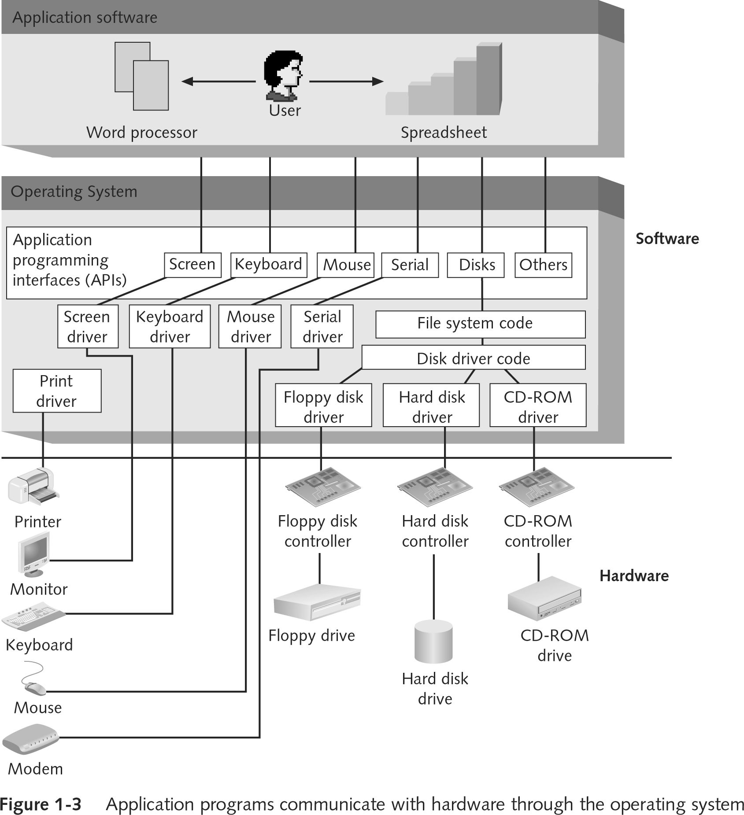
Operating System Architecture
The operating system is an abstraction between the computer hardware and the user.

Slide 6
Popular Components Of Modern Operating Systems
Boot loader – a simple program to load the OS from volatile storage at startup.
Kernel – the heart of the OS. Responsible for processes, memory, protection and devices
File System – an abstraction for the storage of data on disk.
Network Stack – an implementation of network protocols for computer to computer communication
Services – background process to support basic operation.
UI – allows users to interact with the OS. There are command shells like bash or cmd.exe as well as graphical user interface shells, like explorer or finder.

Slide 7
Startup
A bootstrap program is loaded at power-up or restart
Typically stored in ROM or EPROM, generally known as firmware or BIOS
Initializes all aspects of system (hardware)
Loads operating system kernel and starts execution
The kernel takes over and loads the rest of the Operation System.
The kernel continues to provide a connection between the application software and the hardware fro this point forward.

Slide 8
The Key OS Kernel Responsibilities
Process Mgmt
Memory Mgmt
I/O Mgmt
Network Mgmt
Security
Notes:
Process management
Memory management
I/O and Network Management
Protection / Security

Slide 9
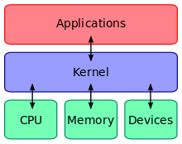
Operating Systems Operations
Dual-mode operations allows an OS to protect itself and other system components
Two modes are User mode and kernel mode
Provides ability to distinguish when system is running user code or kernel code
Some instructions designated as privileged, only executable in kernel mode
System call changes mode to kernel, return from call resets it to user

Slide 10
Process Management
A process is a program in execution. It is a unit of work within the system. A program is a passive entity, a process is an active entity.
A process needs resources to accomplish its task
CPU, memory, I/O, files
Initialization data
Handling programs in initialization, execution, and termination
Task scheduling
Program Execution / Termination
Process termination reclaims any reusable resources
Single-threaded processes have one program counter specifying location of next instruction to execute
Process executes instructions sequentially, one at a time, until completion
Multi-threaded processes have one program counter per thread

Slide 11
Multitasking / Multiprocessing
Multitasking – each application runs as a separate task
Multithreading – parts of the same application can run as separate tasks (video and image processing)
Multiprocessing – when a computer has multiple CPUs / Cores, a single running application can thread across cores
Multiprocessor systems continue to grow in use and importance.
Advantages include:
Increased throughput
Economy of scale
Increased reliability (fault tolerance)
Two types:
Asymmetric Multiprocessing – each processor is assigned a specific task.
Symmetric Multiprocessing – each processor performs all tasks

Slide 12
Memory Management
To execute a program all (or part) of the instructions must be in memory
All (or part) of the data that is needed by the program must be in memory.
Memory management determines what is in memory and when
Optimizing CPU utilization and computer response to users
Memory management activities
Keeps track of which parts of memory are currently being used and by what processes
Deciding which processes and data to move into and out of memory
Allocating and de-allocating memory space as needed
NUMA Awareness
NUMA – Non-uniform Memory Access

Slide 13
Memory management (cont.)
Virtual memory – the presentation of more memory to applications than is available by using disk.
Paging – a block of continuous memory of a predetermined size
Page faults – occurs when an application accesses a page that has been virtualized to disk and therefore needs to be re-loaded back into memory

Slide 14
Storage Management
The OS provides a uniform, logical view of information storage
Abstracts physical properties to logical storage unit - files
Each medium is controlled by device (i.e., disk drive, tape drive)
File-System management
Organizing of files, usually into directories
Access control to determine who can access what files
OS activities include:
Creating and deleting files and directories
Manipulating files and directories
Mapping files onto secondary storage
Backup files (locally or to separate, non-volatile storage media)

Slide 15
I/O and Network Management
Disk management functions such as free space management, storage allocation, de-fragmentation.
Hardware Devices – Device drivers provide an interface for interaction between the device and the operating system.
Networking – implementation of network protocols for computer to computer communication
One purpose of an OS is to obfuscate hardware devices from the user
I/O subsystem is responsible for
Memory management of I/O including buffering (storing data temporarily while it is being transferred), caching (storing parts of data in faster storage for performance), spooling (the overlapping of output of one job with input of other jobs)
General device-driver interface
Drivers for specific hardware devices

Slide 16
Security
Protection – any mechanism for controlling access of processes or users to resources defined by the OS
Security – defense of the system against internal and external attacks
Huge range, including denial-of-service, worms, viruses, identity theft, theft of service
Systems generally first distinguish among users, to determine who can do what
User identities (user IDs, security IDs) include name and associated number, one per user
User ID then associated with all files, processes of that user to determine access control
Group identifier (group ID) allows set of users to be defined and controls managed
Privilege escalation allows user to change to effective ID with more rights

Slide 17
User Interfaces
“The user interface is the space where interactions between humans and machines occur.”
The goal is to allow effective operation and control of the machine from the human end, while the machine feeds back information that aids the users decision making process.
Typically the goal is to produce a UI which makes it easy (self explanatory), efficient (fast), and enjoyable (user friendly) to operate a machine.
The term user interface is generally assumed to mean the graphical user interface (GUI), but command-line (CLI) interfaces also exist for a deeper interaction with the machine and purposes of automation.

Slide 18
Command-line Interfaces
A command-line interface (CLI) is a means of interacting with a program where the user issues commands to the program in the form of successive lines of text.
The CLI was once the primary means of interaction with most computer systems.
The interface is usually implemented with a command line shell, which is a program that accepts commands as text input and converts commands to appropriate operating system functions.
Command-line interfaces are less widely used by casual computer users, but typically preferred by more advanced computer users, as they often provide a more concise and powerful means to control a program or operating system.
Programs with command-line interfaces are generally easier to automate via scripting.

Slide 19
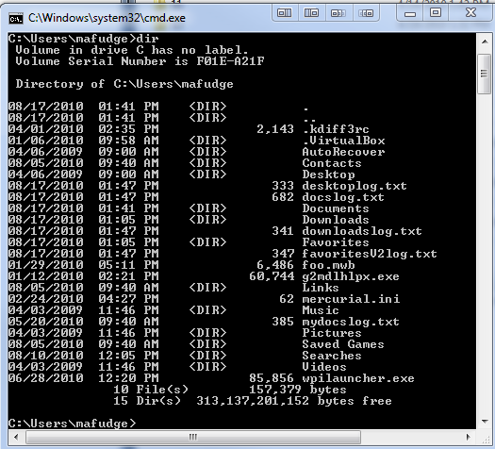
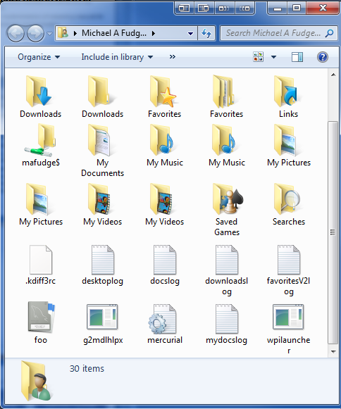
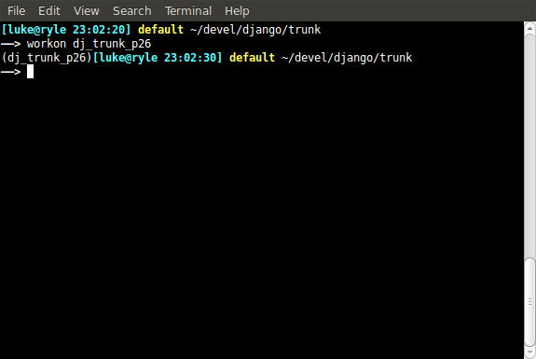
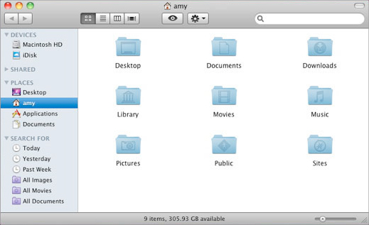
User Interfaces
CLI
GUI

Slide 20
So just what is “Virtualization”?

Slide 21
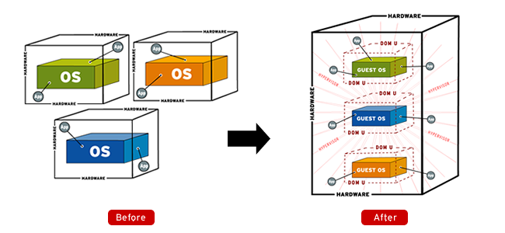
Virtualization – a definition
In computing, this is the creation of a virtual (rather than actual) version of something, such as a hardware platform, operating system (OS), storage device, or network resources.
Generally referred to as “server virtualization”, but can mean a few things.

Slide 22
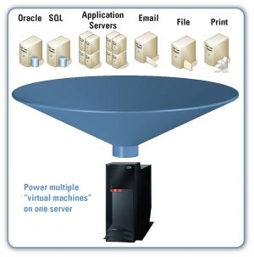
What can we virtualize?
Hardware (server)
Desktop (VDI)
Software
Memory
Storage
Network
Data

Slide 23
Hypervisor
A Hypervisor is the kernel or the core of a virtualization platform. The Hypervisor is also referred to as the Virtual Machine Monitor.
The Hypervisor has access to the physical host hardware.
Of the total amount of disk space taken for a virtualization platform, the Hypervisor is by far, the smallest part.

Slide 24
Hypervisors – two basic types
Type-1 Hypervisor
Type-2 Hypervisor
In a Type-1, or Bare Metal Virtualization platform there really isn’t a host operating system besides the Hypervisor.
VMWare ESX
Hyper-V Windows Core
XEN
For a Type-2 Hypervisor, the host operating system is whatever operating system those applications are installed into.
VMWare Workstation
VMWare Fusion
VirtualBox
Hyper-V on Windows 10

Slide 25
Host vs. Guest
A host system would be the primary & first installed operating system.
Your host is what your VMs will run on and will manage them.
A guest system (guest operating system) is a virtual guest or virtual machine (VM) that is installed under the host operating system.
Guests are the VMs that you run within your virtualization platform.

Slide 26
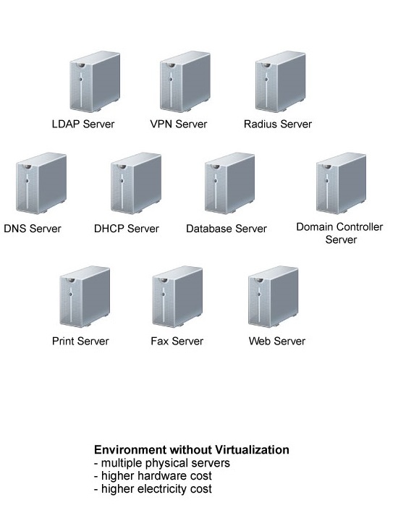
Before Server Virtualization
Multiple servers each on its own hardware
Separate physical servers for each OS/Application
Server sprawl
Inefficient use of resources – most servers sit idle doing their “one job”

Slide 27
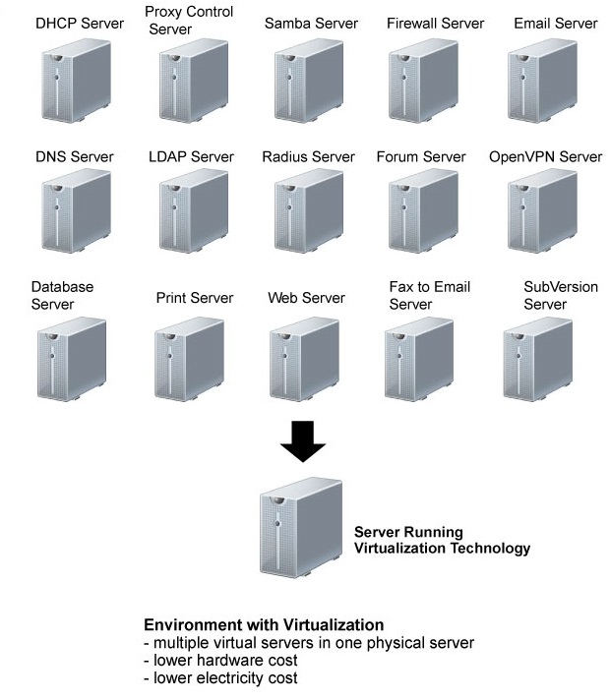
After Server Virtualization
Virtual Servers
Still have multiple servers but, fewer physical hosts
Smaller hardware footprint, uses less energy and data center space.
Maximizes use of hardware /compute resources, Enables IT departments to run more with less.
Actual Hardware

Slide 28
Advanced Capabilities

Slide 29
More That Virtualization Offers Over Physical Hardware
Live Migration
High availability (failover)
Network isolation without network hardware
Snapshotting
Cloning
Teleportation
Consolidated backup
Resource pooling
P2V conversion

Slide 30
Live Migration
Allows for the moving of virtual workloads from one physical host to another with no downtime.
Moving of a running VM to a different physical machine without disconnecting the guest or applications running on it.
Memory, storage, and network connectivity are transferred from original host to the destination.
Typically down-time of a VM during a live migration is not noticeable by end-users. This is referred to as a seamless live migration.

Slide 31
High availability (failover)
Utilizing “Clustering” concepts to use more than one physical host configured and managed as a single resource.
Allows VMs to be run from multiple physical hosts.
In HA configurations, if the physical host becomes unavailable, a VM can be serviced by another host in the cluster.
This is typically configured for Real Time failovers (no loss of a VM’s operation), but there are situations where their will be delays (disaster recovery in hot/cold sites).
Utilizes Live Migration

Slide 32
Network isolation (virtual networking)
Using software to create “virtual networks” without additional network hardware.
Allows you to run multiple identical copies of an environment.
Uses the creation of “virtual networks” to keep computers within from either contacting external networks, or from external devices communicating in.
Some reasons why we would want to do this:
Labs
Test environments
Development
Research
Security

Slide 33
Snapshotting
Dumping the entire machine state to a backup file
Can include contents of memory (live snapshots)
Allows for full system state restore in case of failure or changes made
Can merge the changes from snapshots into the master if needed
Warning: snapshots increase complexity and disk space, so they need to be monitored and removed when no longer needed.

Slide 34
Cloning
A clone is a copy of an existing virtual machine
Changes made to the clone do not affect the parent machine
Two types of clones, Full (independent) and Linked.
Full clone is just that, a full and independent copy that shares nothing with the parent VM. This requires more disk space but keeps the VMs completely independent of one another.
Linked clone is a copy that shares virtual disks with the parent VM in an ongoing manner. This conserves disk space and allows multiple VMs to use the same software configuration.

Slide 35
Consolidated backup
Provides a single location to backup from, simplifying backup strategies.
Can reduce or eliminate network traffic by keeping backups local to the Hosts.
Allows for backup management from a single point.
Can perform file level or complete VM backups.
Restores can be of individual files or bare-metal (whole VM)

Slide 36
Resource Pooling
Ability to “Pool” physical resources together to get more “bang for your buck”
Manually or Dynamically allocate resources to highest priority servers as needed.
Pools are typically defined by CPU and memory resources

Slide 37
P2V conversion
Physical to Virtual conversion
Refers to the migration of an Operating System (along with its applications and data) from a physical computer’s hard disk to a virtual machine.
Allows the conversion to virtualized machines without having to rebuild computers.
Without this you had to reinstall the OS, reinstall all applications, copy all data, and reconfigure the applications and services running (tedious process).
Typically used to accomplish server virtualization.

Slide 38
Benefits of Virtualization
Reduces hardware footprint (physical servers)
Reduces operating costs (long term)
Server hardware
Infrastructure costs
Servers can be created quickly (and removed)
Reduce admin overhead (single console)
Maximizes investment in hardware
Virtualized servers have the same hardware configuration
Easier to power virtual machines on and off

Slide 39
How does it all manifest in the “Cloud” - Virtualization
In AWS - Q: Is a Dedicated Host a baremetal offering?
No, the instances that run on a Dedicated Host are the same virtualized instances that you’d get with traditional EC2 instances that use the Nitro or Xen hypervisor.
In Azure – Q: Is Dedicated Host a bare metal as a service solution?
No. It provides a virtualized environment that’s architected to run Azure VMs, and it gives you control and visibility over the underlying physical server, but it’s not a bare metal as a service offering.

Slide 40
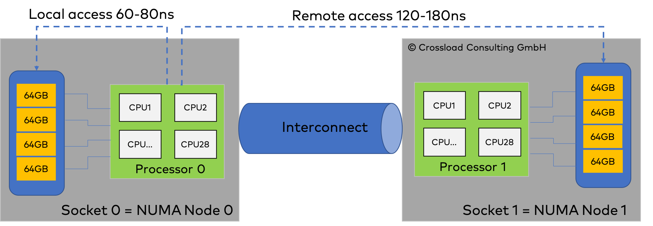
“BareMetal” offerings
https://docs.microsoft.com/en-us/azure/virtual-machines/workloads/sap/hana-overview-architecture

Slide 41
Why do these offerings exist?
SAP uses a lot of memory so offerings like this helps to avoid such problems

Slide 42
P2V and or V2V
https://aws.amazon.com/server-migration-service/
Q: What kind of servers can be migrated to AWS using AWS Server Migration Service?
Currently, you can migrate virtual machines from VMware vSphere and Windows Hyper-V to AWS using AWS Server Migration Service.

Slide 43
Live Migration
https://azure.microsoft.com/en-us/blog/improving-azure-virtual-machine-resiliency-with-predictive-ml-and-live-migration/

Slide 44
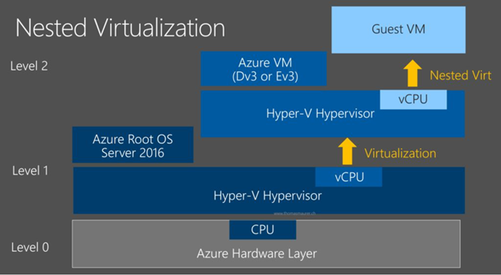
Nested Virtualization
https://aws.amazon.com/blogs/compute/running-hyper-v-on-amazon-ec2-bare-metal-instances/

